Slide 1
SDR Software Defined Radio
Groupe MegaGiga ASBL
December 2024
This document is released under the conditions of the MIT license.

Slide 2
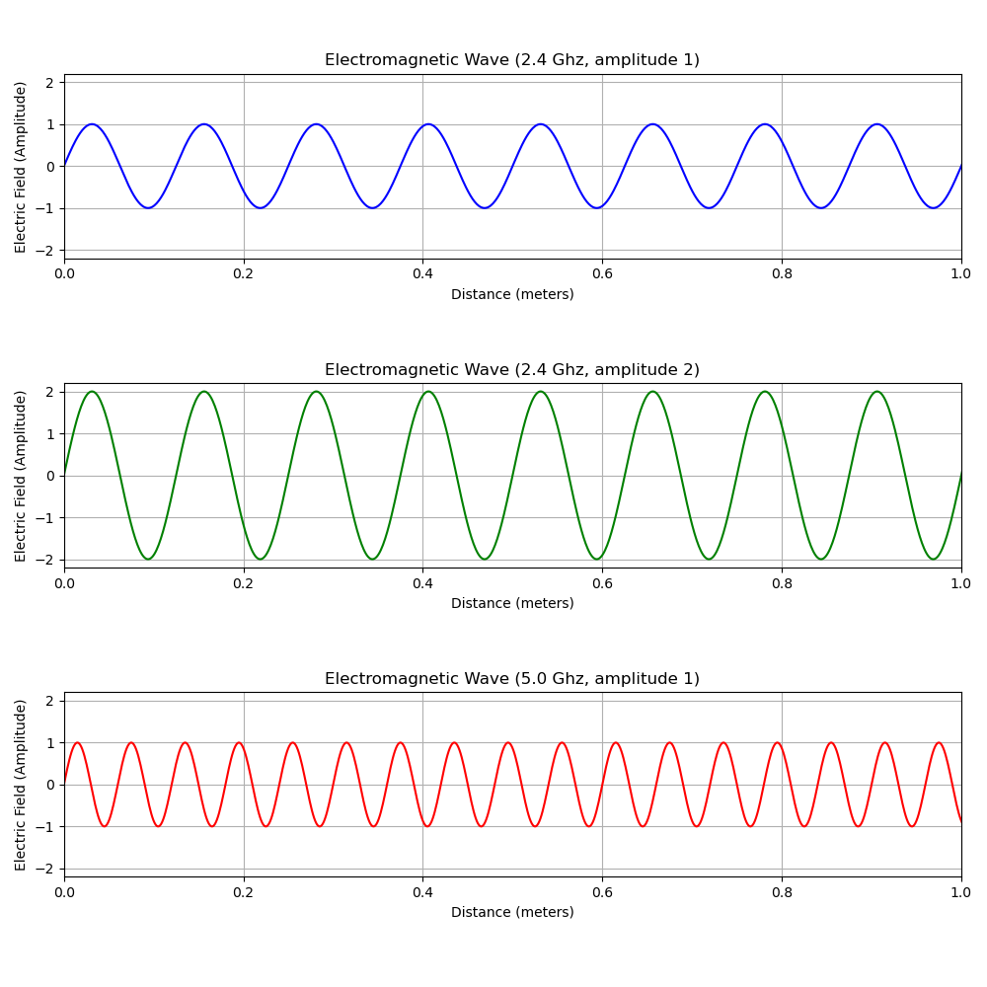
SDR Electromagnetic waves

Slide 3
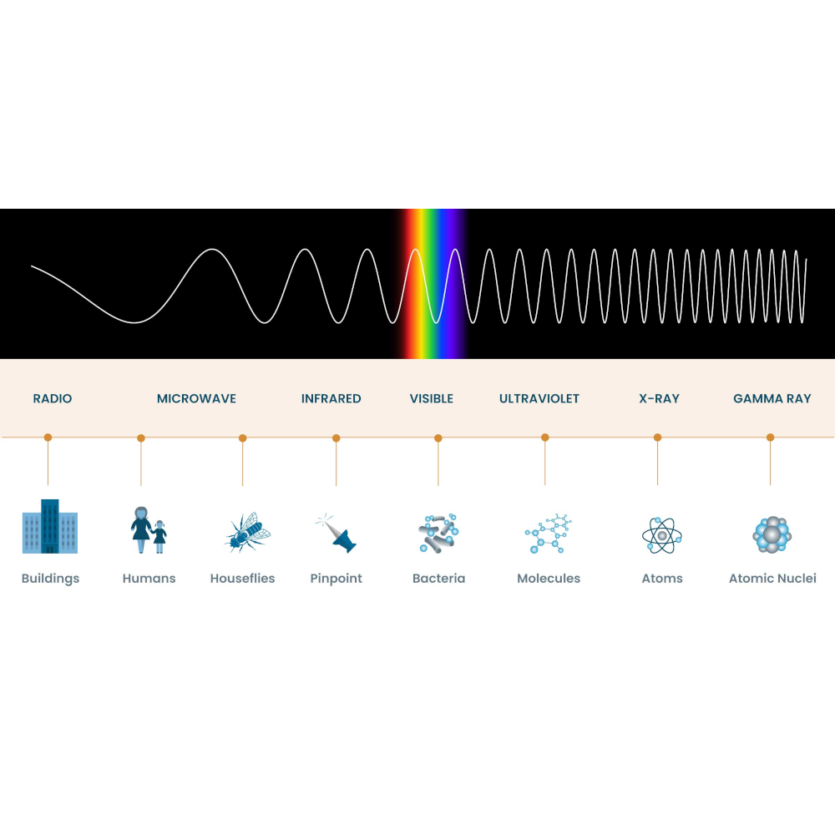
SDR Electromagnetic spectrum

Slide 4
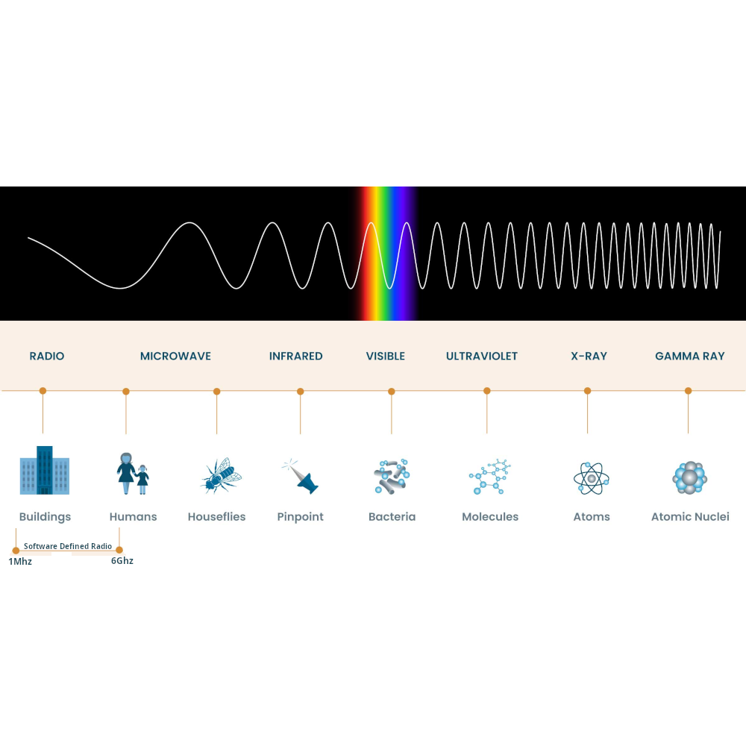
SDR Place withing the spectrum

Slide 5
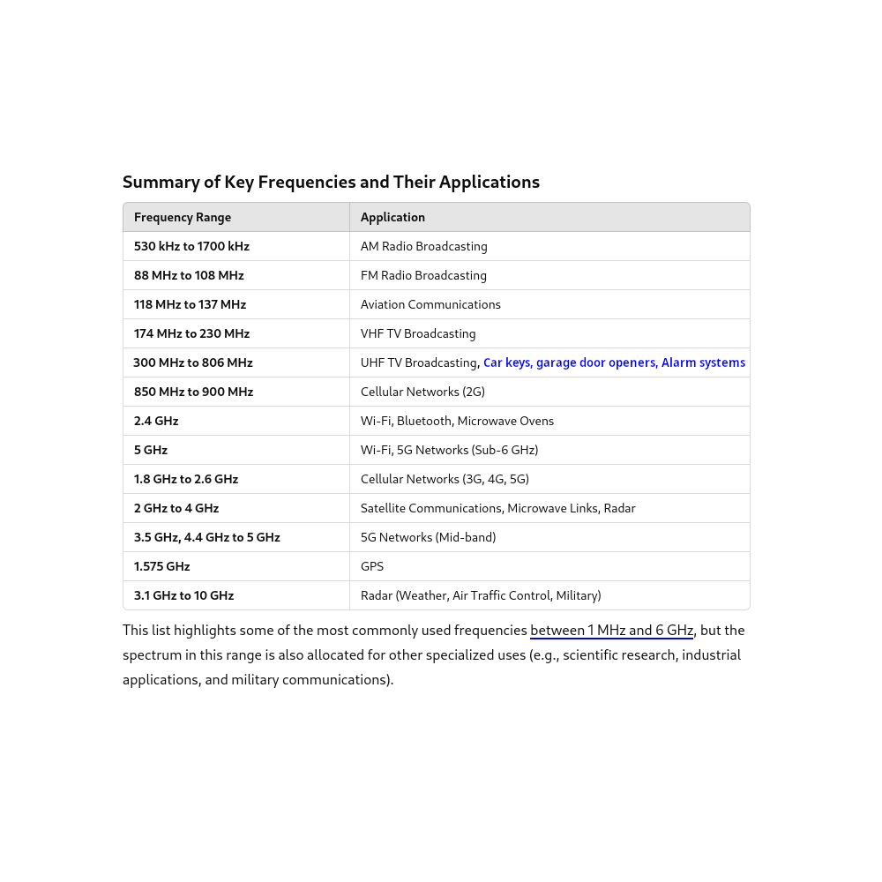
SDR Key frequencies between 1Mhz and 6Ghz

Slide 6
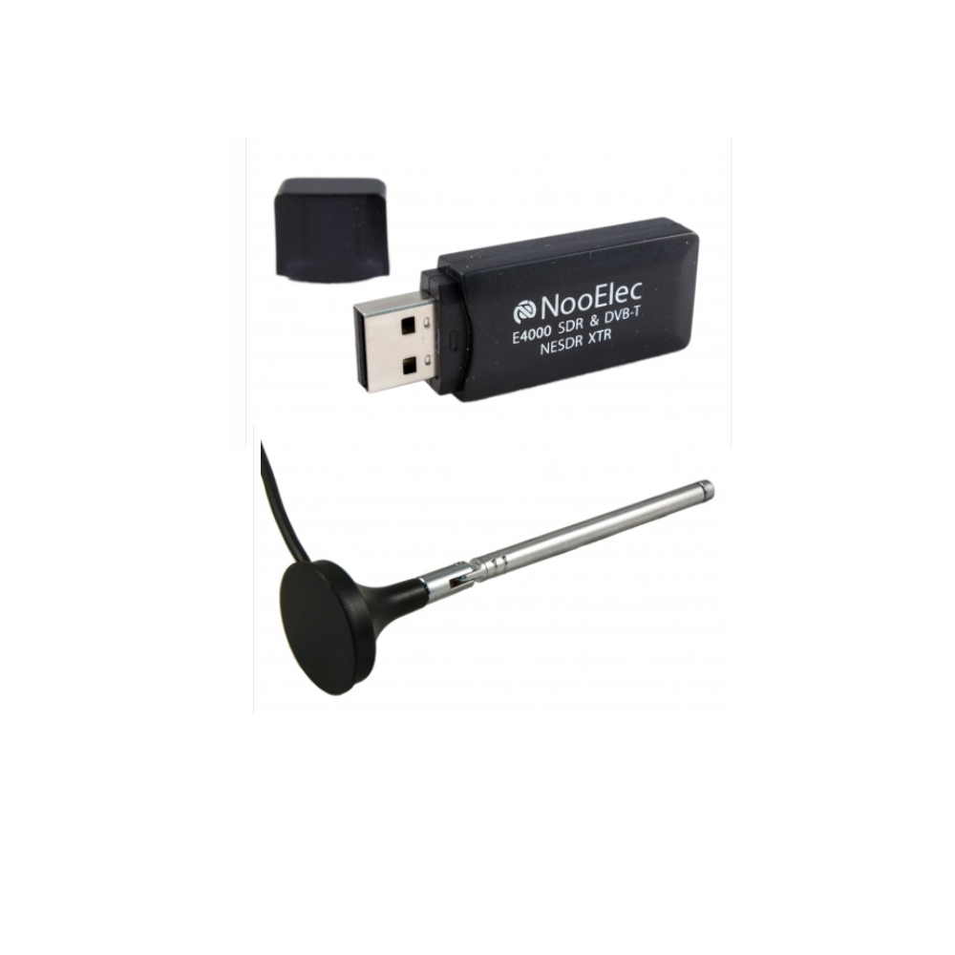
SDR Hardware – NooElec E4000

Slide 7
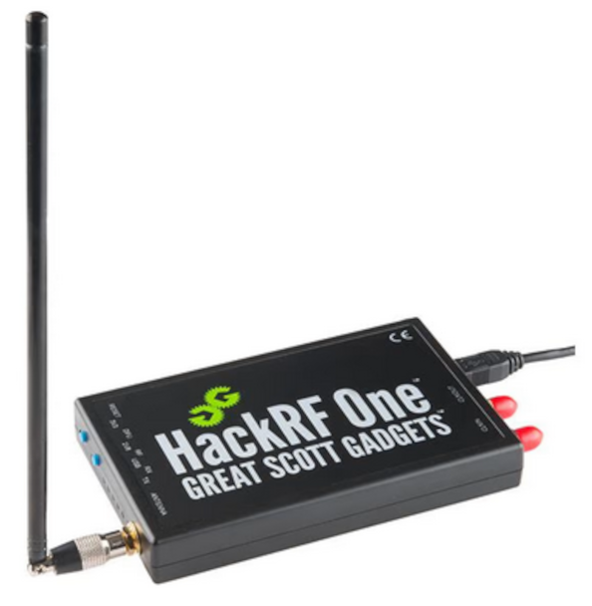
SDR Hardware – HackRF One

Slide 8
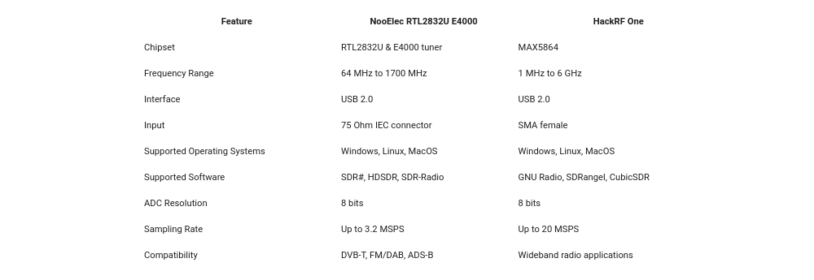
SDR Hardware – Specifications

Slide 9
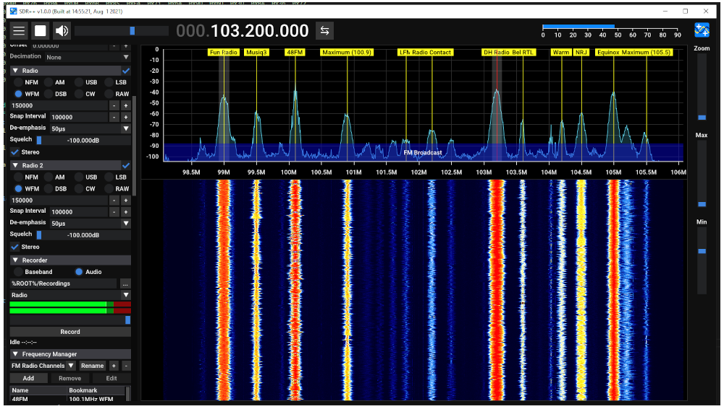
SDR Software - Sdr++

Slide 10
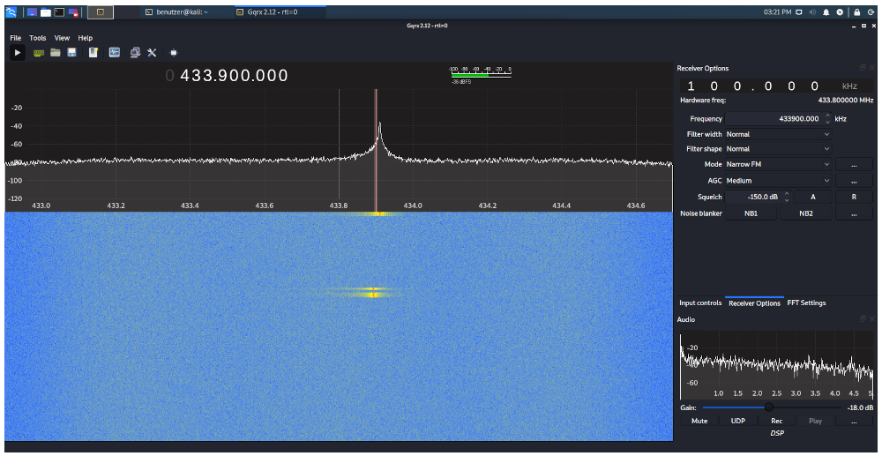
SDR Software - Gqrx

Slide 11
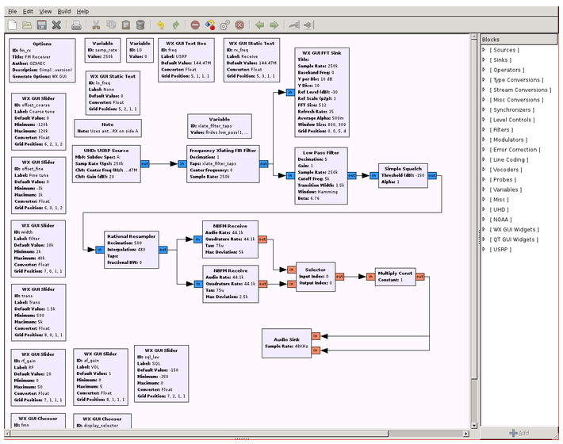
SDR Software - Gnu Radio Companion

Slide 12
SDR Software - Gnu Radio Companion

Slide 13
SDR Software Defined Radio
Demonstration:
sdr++
Gnu Radio Companion
Gnu Radio Companion Python

Slide 14
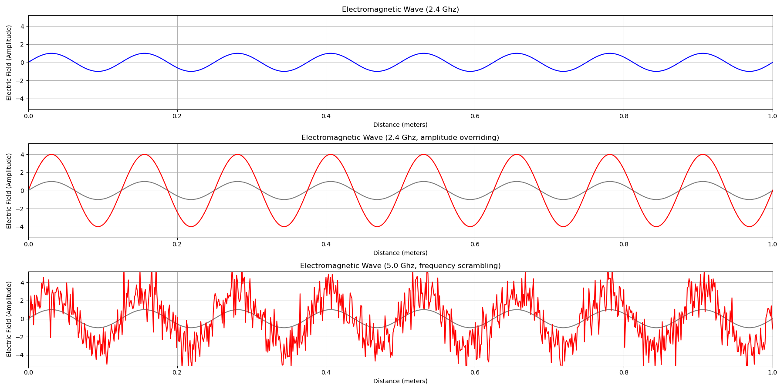
SDR Scrambling

Slide 15
SDR Software Defined Radio
No - Demonstration:
Since signal scrambling is illegal in most countries, we could not possible recommend doing it, not even for fun or for test purposes, without taking the necessary precautions to contain your scrambling signal within the perimeter of a Faraday cage or a Sarcophagus. Hence, we could not possibly demonstrate signal scrambling without being naughty boys, which we aren’t so we won’t.

